Slide 1
BINARAY LOGISTIC REGRESSION MODEL CROSS VALIDATION

Slide 2
Contents
Cross Validation
Hold out validation
Confusion matrix
K-fold validation

Slide 3
Cross Validation in Predictive Modeling
Cross Validation is a
process of evaluating the model on
‘Out of Sample’ data
Model performance measures for binary logistic regression such as Accuracy rate, Sensitivity, Specificity tend to be optimistic on 'In Sample Data'
More realistic measures of model performance are calculated using "Out of Sample' data
Cross-validation is a procedure for estimating the generalization performance in this context
Cross validation is important because although a model is built on historical data, ultimately it is to be used on future data. However good the model, if it fails on out of sample data then it defeats the purpose of predictive modeling

Slide 4
Cross Validation in Predictive Modeling
There are different approaches for cross validation. Five most significant of them are:
We will focus on Hold Out and K-Fold Cross validation methods.
Hold-Out Validation
K-Fold Cross Validation
Repeated K-Fold Cross Validation
Resampling Validation Method (Bootstrap Method)
Leave-One-Out Cross Validation (LOOCV)

Slide 5
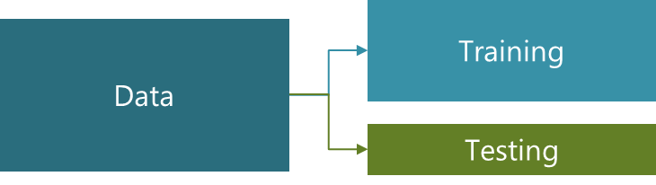
Hold-Out Validation
In Hold-Out validation method, available data is split into two non-overlapped parts: 'Training Data' and 'Testing Data'
The model is
Developed using training data
Evaluated using testing data
Training data should have more sample size. Typically 70%-80% data is used for model development
*
Here we continue to use previous data of bank loan for our further analysis.

Slide 6
Hold Out Validation in R
# Install and Load “caret” package
# Create 2 groups of the data: Training and Testing
install.packages("caret") library(caret) data <- read.csv("BANK LOAN.csv", header=TRUE) index<-createDataPartition(data$DEFAULTER, p=0.7, list=FALSE) dim(index) traindata<-data[index,] testdata<-data[-index,]
createDataPartition() generates list of observation numbers to be included in training data.
p= is the percentage of data that goes into training.
list= specifies if results should be in a list format or matrix.

Slide 7
Hold Out Validation in R
# Check the dimensions of
dim(traindata) [1] 490 8 dim(testdata) [1] 210 8
The data of 700 observations are partitioned into 2 parts:
With 490 observations in training (model development) part and remaining 210 observations in testing data part (out of sample).

Slide 8
Hold Out Validation
Model will be run on the training data and predicted probabilities will be generated.
Same model will be applied to test data to get the predicted probabilities.
Confusion matrix will be used to check the performance of the model in training and testing data.

Slide 9
Confusion Matrix
 | Observed
Predicted | Event | No Event
Event | A | B
No Event | C | D
Sensitivity = A/(A + C)
Specificity = D/(B + D)
Prevalence = (A + C)/(A + B + C + D)
Positive Predicted Value = A / (A + B)
Negative Predicted Value = D / (C + D)
Detection Rate = A/(A + B + C + D)
Detection Prevalence = (A + B)/(A + B + C + D)
Balanced Accuracy = (Sensitivity + Specificity)/2
Precision = A/(A + B)
Recall = A/(A + C)

Slide 10
Confusion Matrix in R
# Generate confusion matrix for training data
riskmodel<-glm(DEFAULTER~EMPLOY+ADDRESS+DEBTINC+CREDDEBT, family=binomial,data=traindata) traindata$predprob<-predict(riskmodel,traindata,type='response') traindata$predY<-ifelse(traindata$predprob>0.30,1,0) traindata$predY<-factor(traindata$predY) traindata$DEFAULTER<-factor(traindata$DEFAULTER) confusionMatrix(traindata$predY,traindata$DEFAULTER,positive="1")
# Generate confusion matrix for test data
testdata$predprob<-predict(riskmodel,testdata,type='response')
testdata$predY<-ifelse(testdata$predprob>0.3,1,0)
testdata$predY<-factor(testdata$predY)
testdata$DEFAULTER<-factor(testdata$DEFAULTER)
confusionMatrix(testdata$predY,testdata$DEFAULTER,positive="1")
confusionMatrix() creates cross-tabulation of observed and predicted classes with associated statistics. The function contains data, reference.
positive= factor level that corresponds to a “positive” result (Y=1).

Slide 11
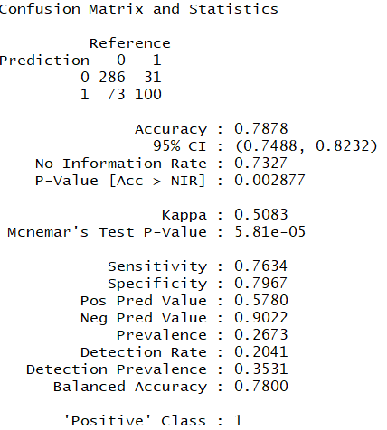
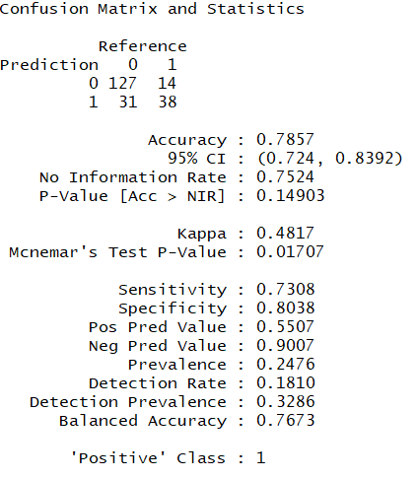
Confusion Matrix in R
# Output:
For Training data For Testing data
Interpretation :
Accuracy of both the data is almost same. Sensitivity is also similar of both the datasets. Model is performing well for test data.
*
Note : Since the Train –test data is chosen randomly, output may vary slightly on different devices.

Slide 12
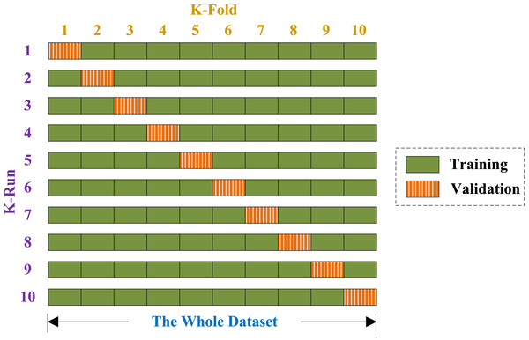
K fold Cross Validation
In k-fold cross-validation the data is first partitioned into k equally (or nearly equally) sized segments or folds.
Then k iterations of training and testing are performed such that each time one fold is kept aside for testing and model is developed using k-1 folds.

Slide 13
K-fold Validation in R
# Create k-folds
library(caret) kfolds<-trainControl(method="cv",number=4) riskmodel<-train(as.factor(DEFAULTER)~EMPLOY+ADDRESS+ DEBTINC+CREDDEBT,data=data,method="glm", family=binomial,trControl=kfolds) riskmodel
trainControl() control the computational nuances of the train function.
method=“cv” tells R to use Cross Validation method.
number= specifies the number of folds.
train () fits predictive models over different tuning parameters.
It performs a number of classification and regression routines, fits each model and calculates a resampling based performance measure.
trControl= specifies the train function.

Slide 14
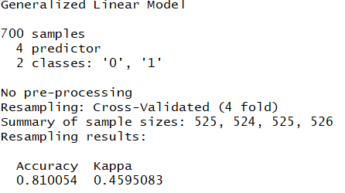
K-fold Validation in R
# Output:
Interpretation : accuracy of 0.81 indicates the good model.
*
Note : Since observations are assigned randomly in kfolds, output may vary slightly on different devices.

Slide 15
K-fold Validation in R
# Generate confusion matrix for k-fold validation
library(caret) data$pred<-riskmodel$finalModel$fitted.values data$predY<-ifelse(data$pred>0.3,1,0) data$predY<-factor(data$predY) data$DEFAULTER<-factor(data$DEFAULTER) confusionMatrix(data$predY,data$DEFAULTER,positive="1")
riskmodel$finalModel$fitted.values: Extract fitted model values from “riskmodel”.

Slide 16
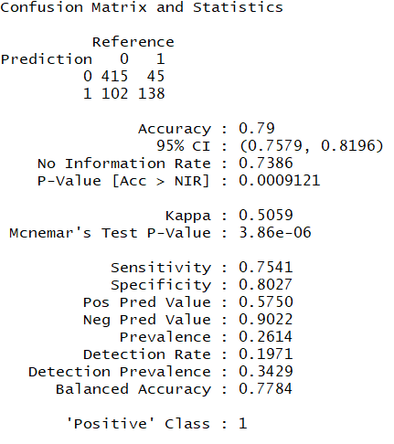
K-fold Validation in R
# Output:
Interpretation : sensitivity and accuracy indicates stable model.

Slide 17
Quick Recap
In this session, we studied about model validation of Binary Logistic :
Cross Validation
Cross Validation is a process of evaluating the model on ‘Out of Sample’ data.
Hold out validation
In Hold-Out validation method, available data is split into two non-overlapped parts: 'Training Data' and 'Testing Data’.
Confusion matrix
It is used to check the performance of the model in training and testing data.
It has performance measures as Accuracy, sensitivity, specificity, etc..
K-fold validation
In k-fold cross-validation the data is first partitioned into k equally (or nearly equally) sized segments or folds.
Then k iterations of training and testing are performed such that each time one fold is kept aside for testing and model is developed using k-1 folds.

Slide 18
THANK YOU!!

